Slide 1
PDS
SDN
NFV
Computer Vision
10.2_Aplikasi: COMPARATORS ELECTROCARDIOGRAM (ECG)
https://github.com/siagianp
https://www.youtube.com/@AmelOline/videos
https://github.com/amelcharolinesgn2/IoT_simulator-mqtt-NodeRed
https://github.com/amelcharolinesgn2/Cloud-Infrastructures
https://github.com/amelcharolinesgn2/ClouD-Infrastructure-SISKA-2025
Notes:
http://www.sophphx.caltech.edu/Physics_5/Experiment_6.pdf
https://ocw.mit.edu/ans7870/RES/RES.6-010/MITRES_6-010S13_comchaptrs.pdf

Slide 2
Outline:
Sensing for health:
Vital signs sensors
Disease sensors
Environmental sensing (mention only)
Networking:
Requirements for health sensing
Wired (serial/USB) and wireless (Bluetooth) systems for sensing, cell phones etc.
ELECTROCARDIOGRAM (ECG)

Slide 3
Vital Signs/Basic Health sensing
Vital Signs:
Body temperature
Blood pressure
Pulse (pressure)
Pulse (oximetry)
Pulse (ECG electrical)
Stethoscope (acoustic chest measurements)
Pedometers (walking, running)
Weight/Body fat

Slide 4
Disease Monitoring
Asthma
Diabetes
Blood Glucose
Non-invasive methods
Heart problems – EKG monitoring

Slide 5
Environmental Sensing (later)
Air Quality
Particulate matter
Sulfur oxides
CO
CO₂, Nitrogen oxides, hydrocarbons…
Water Quality
Bacteria: Typhoid, Cholera, E-coli
Protozoa: Cryptosporidium and Giardia
Viruses: Hepatitis, many types of diarrhoea
Helminths: Parasitic worms, Ascariasis, Hookworm
Arsenic: responsible for > 200,000 deaths/year

Slide 6
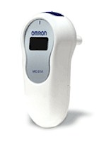
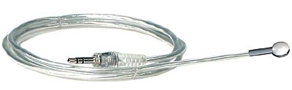
Basic Health - Temperature sensors
Simplest form of sensor. Quite a few of these on the market, several have PC interfaces.
Electronic versions use small thermal sensing elements – fast response.
Omron thermometer
Pasco PasPort temp. sensor

Slide 7
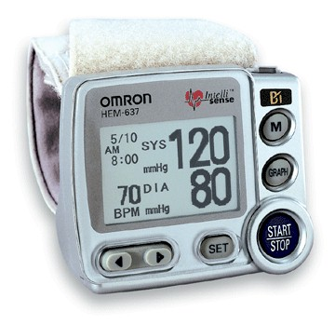
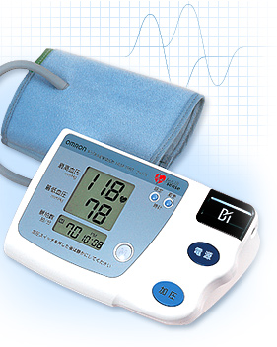
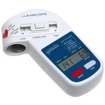
Blood Pressure Monitors
The most accurate versions are arm cuff models.
There are also finger, or wrist-style models. But location relative to heart height is critical. Latest wrist models include smart sensing to position at the correct height.
Omron wrist, arm and finger models

Slide 8
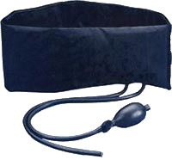
Pulse pressure sensing
Pulse sensing is normally done by blood pressure monitors, but they require high pressure inflation – enough to halt blood flow – and are not suitable for continuous monitoring.
Continuous pressure monitoring can be done on many parts of the body, e.g. the waist:
Vernier respiration belt

Slide 9
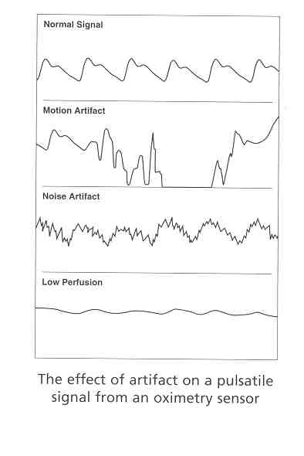
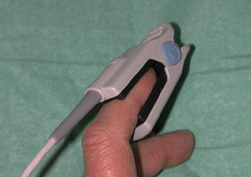
Pulse oximetry
Pulse oximetry. A light source/sensor on a finger senses light transmission at 650nm and 805nm.
These wavelengths are absorbed selectively by oxygenated and non-oxygenated blood.
An oximeter signal varies at pulse rate.

Slide 10
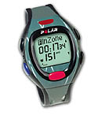
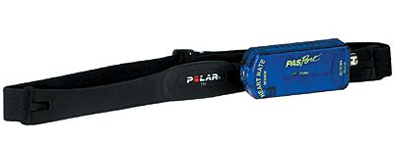

ECG-based heart rate
Electrical signals can be used to determine heart rate. Polar makes several of these devices with wireless interfaces, and the raw data can be captured and used in exercise monitoring.
Polar E600 wrist monitor
Polar/PasPort wireless exercise ECG sensor
Polar IR/PC interface

Slide 11
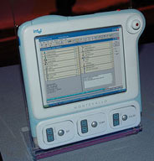
Electronic Stethoscopes
A sound transducer connected to a stethoscope head is a very convenient form of the traditional stethoscope. The electronic version can provide amplification, recording, and minimizes artifacts due to cord contact with clothing etc.
Wireless (Bluetooth) Stethoscope Head
Intel Physician’s Tablet

Slide 12
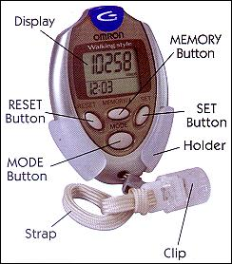
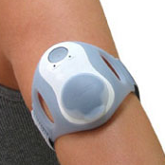
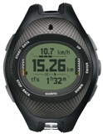
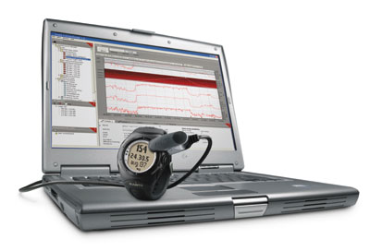

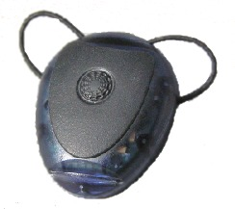

Exercise pedometers
Omron
Accelerometer-based sensors detect leg motion. Sensor typically mounted in the shoe or at the waist.
Suunto’s T6, Footpod and X9i
Fitsense pacer and bodylan
BodyMedia BodyBugg

Slide 13
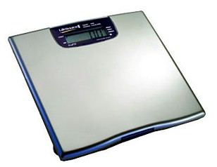
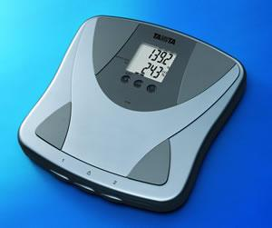
Electronic Weight/Body fat Scales
There are several weight scales on the market with digital interfaces. Tanita developed a scheme called BIA to estimate body fat as well, and several other manufacturers followed suit. BIA is “Bioelectrical Impedance Analysis”.
A&D Lifesource scale with RS232
Tanita body fat scale

Slide 14
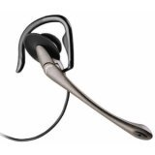
Disease Monitoring - Asthma
The Lancet paper in the readings argues that regular cell phones can be used for Asthma breath monitoring.
Ideas:
a regular cell phone can be held against the throat,
Or a dedicated wireless microphone could be attached near the throat for full-time monitoring.
Wireless headsets are an option, or dedicated microphones… Jabra, Motorola, etc.

Slide 15
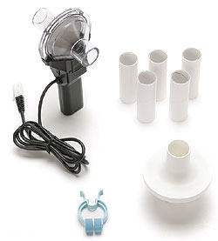
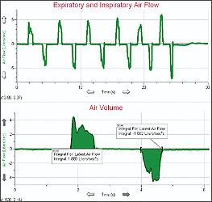
Asthma - Breathing monitors
Spirometers directly measure breath flow. They can be used for live measurements into a PC.
Vernier Spirometer

Slide 16
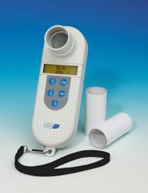
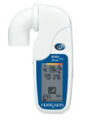
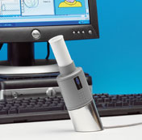
Asthma - Breathing monitors
Electronic flow meters that store readings are very useful for Asthma diaries. It has been shown that children door a poor job of manually maintaining their diaries.
Micromedical SpiroUSB Spirometer
Ferraris Koko electronic,
recording flow meter
Micromedical MicroDiaryCard recording Spirometer

Slide 17
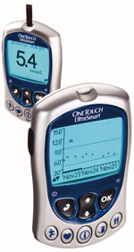
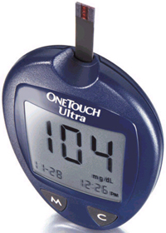
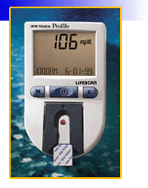
Diabetes
The most direct method is blood glucose measurement. A small blood sample is taken by piercing a finger or arm, and analyzed in a handheld meter.
LifeScan OneTouch blood glucose meters. All of these support PC uploads via a serial (RS232) cable.

Slide 18
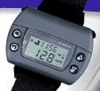
Diabetes – non-invasive methods
The Glucowatch uses a method called “reverse iontophoresis” – a small voltage is applied to the skin which draws out intercellular fluid (with glucose in it). The fluid reacts with a gel in a disposable pad, and causes another electrical signal that measures glucose.
Received FDA approval in 2002
Extremely valuable for high-risk patients
But readings affected by many factors, perspiration etc., not for everyone
Requires (expensive) replaceable pads
Company (Cygnus) sold this year – device future uncertain
Glucowatch G2

Slide 19
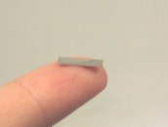
Diabetes – permanent monitors
The best long-term approach seems to be implanted sensors that are accessed wirelessly from outside the body. Many companies (and labs) are working on this.
Craig Grimes (Penn. State) developed a magneto-elastic sensor with a polymer coating that responds to Ph (acidity). An additional layer (glucose oxidase) produces acid in the presence of glucose.
This sensor, and the electronics to access it, would be extremely inexpensive.

Slide 20
Aside – magneto-elastic sensors
Grimes’ group has also demonstrated that these sensors can be tailored to specific pathogens – e.g. disease agents in humans, or in contaminated water.
The extremely low cost of the sensors and reader electronics opens up many opportunities for environmental health testing in developing regions.
Work is needed on two fronts:
Sensor chemistry – tailoring materials that respond to specific agents
Reader electronics – reading the sensors requires electronics with high integration for low cost (e.g. systems-on-a-chip) , or modifications to existing SOC hardware (e.g. rfid tag reader chips).

Slide 21
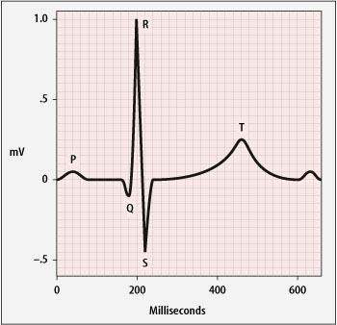
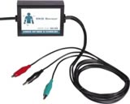
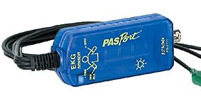
ECG (or EKG) ElectroCardioGram
ECG signals are the electrical traces of heart muscle action on the chest. ECG sensors are normally “3-lead” or “12-lead” (actually 10 electrodes). An ECG signal is quite strong (1mV) but may be immersed in noise from AC appliances, so must be amplified carefully.
3-lead Vernier ECG amp.
PasPort amp.
Single ECG cycle

Slide 22
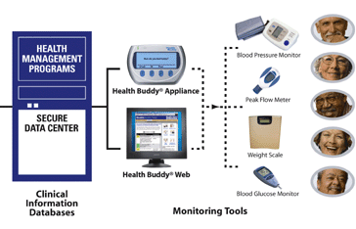
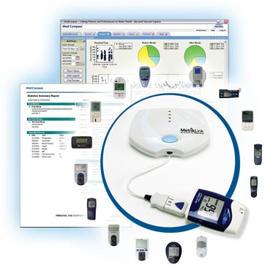
Systems
iMetrikus MediCompass
HealthHero’s Health Buddy

Slide 23
Analog signals: Audio
Stethoscopes:
Several groups (including Intel) have demonstrated electronic stethoscopes.
Respiration:
Asthma breathing sounds at the throat can be remotely diagnosed with a cell phone!
Chewing!:
UBICOMP 2005 paper showed that chewing sounds can be recognized from speech, and several types of food can be distinguished.

Slide 24
Other Analog signals
EKG:
In range 0.5-30 Hz, about 1 mV p-p. Should be compatible with audio connections.
Pulse Oximetry:
This waveform is very similar in shape. Amplitude depends on the specific sensor.
EEG:
True audio range, a few Hz to several hundred. Very low amplitude, high gain, noise rejecting amplifier needed.

Slide 25
Summary of sensing needs
The sensors we described so far fall into a few classes:
Discrete readings: Blood pressure, pulse, temperature, weight, body fat, flow (asthma), blood glucose (diabetes).
Signal capture: Pulse oximetry and pulse pressure (waveforms), EKG, stethoscope readings, breath sounds.
Monitoring: Repeated readings of one of the above, with checking for measurements outside a safe range.

Slide 26
Summary of sensing needs
Discrete readings: Blood pressure, pulse, temperature, weight, body fat, flow (asthma), blood glucose (diabetes). These are analog readings, accurate to a few %. A digital representation of 8 bits or more should be fine.
Aside: many existing discrete reading devices support recording and data transfer over serial (RS232) links.
Signal capture: These signals are either in the audio range (breath sound, stethoscope), or slightly below it (pulse waveforms, EKG). Audio capture (without loss of lower frequencies) should be fine. Precision is not completely clear – the ear is very sensitive. At least 10 bits.

Slide 27
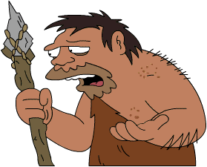
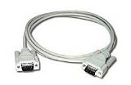
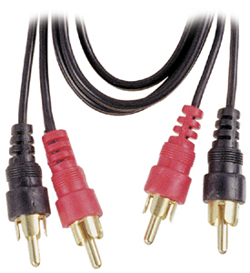
Networking
Once upon a time,
There were just cables…
Keyboard, Mouse,
Video,
Parallel,…
Serial (RS232) cable
Audio cable

Slide 28
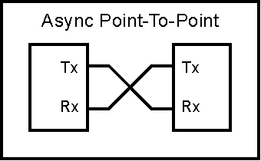
Serial connections
Serial Cables connect two devices symmetrically like this:
Serial ports traditionally support speeds up to 19.2k bit/sec (RS232) but are often used at higher speeds (up to several Mb/s) over short distances.
Traditional serial ports are fast disappearing on computers, but as we saw still exist on many medical devices.
Tx = transmitted data
Rx = received data

Slide 29
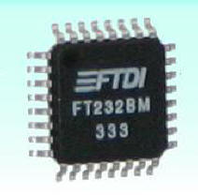
USB (Universal Serial Bus)
USB was the first answer to the proliferation of cables, designed to replace serial, parallel, audio, and other cables.
USB is a 4-wire serial bus with a power (+5 volts) wire.
USB offers speeds of 1.5Mb/s, 12Mb/s and 480Mb/s.
USB is a difficult protocol to use directly, but for general sensor use, it is easy to use a USB/serial cable or bridge chip. Most such bridges use either Prolific or FTDI chips.
FTDI USB/serial bridge. Up to 3Mb/sec. Drivers for Windows, CE, Mac, Linux. Presents a virtual COM port.

Slide 30

USB for Audio
There are also several USB Audio chips.
You install a custom driver on the host computer, and the USB sound device appears as a Windows (or Linux, or Mac) sound device.
The downside of this is that you have to do this install for every device you might use the USB sound device with.
C-media single chip USB Audio system

Slide 31
Bluetooth
Bluetooth is a wireless cable replacement standard.
After a slow start, Bluetooth technology is taking off. Sales for 2005 should exceed 200 million units, and is roughly doubling each year.
Bluetooth comes in two flavors:
Class 2: for personal devices or in-vehicle use, around 10-20m (try 10-20 feet in practice)
Class 1: For longer range up to 100m, e.g. in a household or office.

Slide 32
Bluetooth Data Rates
Bluetooth also comes in two versions.
Version 1 (usually you see 1.1 or 1.2) has data rates up to 723 kb/s.
Version 2 (aka EDR or Extended Data Rate) triples the data rate up to about 2 Mb/s.
Bluetooth shares the 2.4GHz spectrum with WiFi (802.11a,b,g etc.).

Slide 33
Bluetooth Profiles
One of the most useful innovations in the Bluetooth standard is the use of device profiles.
A profile is an abstract device spec. that has to be supported at both ends of a connection.
If you like, it’s the kind of cable(s) that that Bluetooth connection supports. Each connection can support several profiles at once.
Profiles eliminate the need for custom drivers on the host, and allows a Bluetooth device to connect to any host (PC, PDA, cell phone) that supports the profile(s) it uses.

Slide 34
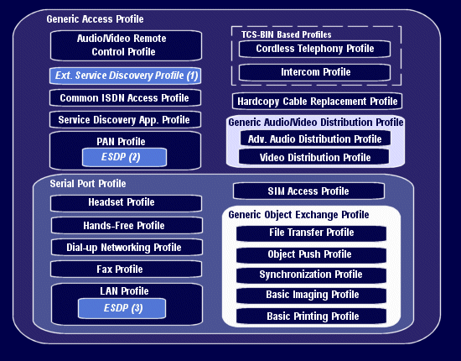
Bluetooth Profiles

Slide 35
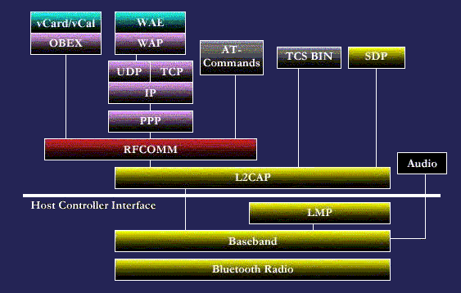
Bluetooth Stack
The message here is that Bluetooth is hairy – like TCP/IP. Older Bluetooth chips only provided HCI functionality. Now they go up to the application layers: SPP, DUN, Headset.

Slide 36
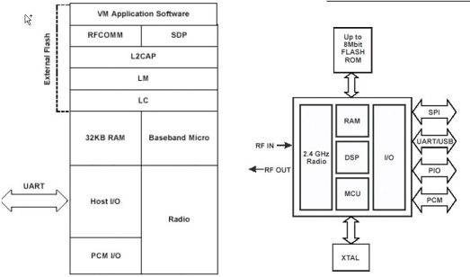
Bluetooth Chips - CSR
Cambridge Scientific Radio (CSR) manufactures a large number of Bluetooth chips, probably more than half of those shipped. This is a diagram of their Bluecore2 series.
This chip fits in a 1cm² package

Slide 37
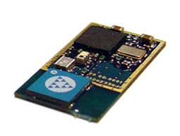
Bluetooth Modules – Free2Move
Bluetooth modules add the components needed to make a working radio: crystal, antenna, flash memory. The current generation of modules measure about 1”x0.5” w/ antenna.
Free2Move (Sweden) has some particularly interesting modules based on CSR BlueCore2-flash chips with audio.
This radio offers a functioning SPP for serial data, a 15-bit audio channel, and another 8-bit A/D channel.

Slide 38
More Bluetooth Hardware
Cambridge Scientific Radio (CSR) chips (in most peripherals)
BlueCore2 chip Bluetooth v1.1, 16-bit XAP2 processor, A/D, audio options BlueCore3 chip Bluetooth v1.1-1.2, XAP2 processor, audio DSP option BlueCore4 chip Bluetooth V2.0, XAP2 processor AT&T Broadcom chips (in many PC + PDAs)
BCM2040 Bluetooth v1.1-1.2, 8-bit 8051 processor BCM2037 Bluetooth v2.0 with audio, 16-bit ARM7 processor BCM2045 Bluetooth v2.0 host side chip Class 2 Modules (with antenna)
Free2Move FM03AC2 Bluetooth v1.1 qualified, SPP, 15-bit audio + 8 bit A/D Taiyo Yuden EYMF2CAMM-XX Bluetooth v1.1 qualified, serial port profile BlueGiga WT12 Bluetooth v2.0 EDR qualified, serial port profile + PCM
Class 1 Modules (no antenna) Free2Move FM2M03C1 Bluetooth v1.1 qualified, SPP, 15-bit audio + 8 bit A/D BlueGiga Wrap Thor 2022 Bluetooth v1.1 qualified, SPP, DUN, OBEX, HID

Slide 39
Developing with Bluetooth
The newest modules make it pretty easy to go wireless. Most modules can be used as serial cable replacements.
The next simplest step is to add a microprocessor to act as controller (PIC etc.), using the module’s serial profile. But since new BT chips have a powerful, energy-efficient processor on-board already, this is rather wasteful.
You can develop for the native processor, but you will need to buy some expensive development tools. CSR and some module vendors provide virtual machines so your code can’t void the module’s qualification.

Slide 40
Bluetooth-to-phone
To call out from a sensor using a Bluetooth cell phone, it may only be necessary to use the phone’s “DUN” (Dialup Networking) profile. The sensor becomes the master of the connection. No code needed on the phone!
Otherwise there are several programming platforms available for phones: Java, BREW, Symbian. BREW is the programming environment for CDMA phones (Qualcomm, Sprint, Verizon,…). Fast and flexible, but you need another expensive development environment (for ARM processors).

Slide 41
Project work
Please write down a project idea to be handed in next time (Wednesday).
Project work starts next week.

Slide 42
Next Time
Jeff Newman, director of Sutter Health Inst. for Research and Education is the guest speaker.
Reading online about telehealth in Finland.
What assumptions does this paper make about the application of telehealth?
What technical innovations would improve the situation?

Slide 43
What is ECG?
A technique of recording bioelectric currents generated by the heart.
It records any problems with the heart’s rhythm, and the conduction of the heart beat through the heart which may be affected by underlying heart disease.
Why is ECG used?
-to check how well medicines are working and whether they are causing side effects that affect the heart.
-to check the health of the heart when other diseases or conditions are present such as high B.P., high cholestrol, diabetes, etc..
-to assess if the patient has had a heart attack or evidence of a previous heart attack.
-to observe the effects of medicines used for coronary heart disease.
-to see if there are too few minerals in the blood.
-to diagnose poor blood flow to the heart, heart attack and abnormalities of the heart.

Slide 44
How does an ECG machine detect the body’s electrical signals?
Up to 12 self-adhesive electrodes will be attached to the selected locations on the skin(limbs and chest).
At rest, across the cell membrane,each heart muscle has a negative charge, called the membrane potential.
Decreasing this negative charge towards zero, via influx of the +ve cations, Na+ and Ca++,is called depolarisation, which activates the mechanisms in the cell that cause it to contract.
A healthy heart will have an orderly progression of a wave of depolarisation,during each heart beat.
This is detected as tiny rises and falls in the voltage between two electrodes placed on either side of the heart which is displayed as a wavy line either on a screen or on paper.
This display indicates the overall rhythm of the heart and weaknesses in different parts of the heart muscle.

Slide 45
ECG characteristics:
-The ECG signal consists of low amplitude voltages in the presence of high amplitude offsets and noise.
-The large offsets present in the system are due to halfcell potential developed at the electrodes.
-Ag/AgCl(Silver-silverchloride) is the common electrode used in ECG systems and has a maximum offset voltage of +/- 300 mV.
-The actual desired signal is +/- 0.5 mV superimposed on the electrode offset.
-In addition, the system also picks up the 50/60 Hz noise from the power lines which forms the common mode signal.
-The amplitude of the power line noise may be very high . So, it has to be filtered.

Slide 46
ECG acquisition:
-Analog front-end processing forms an important part of the ECG system since it needs to distinguish noise and the desired signal which is of small amplitude.
-The front end processing circuitry consists of an instrumentation amplifier which reduces the common mode signal.
-Instrumentation amplifiers that operate on +/- 5V are commonly used to take advantage of the large input voltage range.
-The instrumentation amplifiers should have high input impedance since the skin resistance could be very large.
-Operational amplifiers are needed for signal conditioning for the ECG device.
-The signal chain for the acquisition system consists of instrumentation amplifiers, filters implemented through op-amps, and ACD s.

Slide 47
ECG filtering:
Signal processing is a huge challenge since the actual signal value will be 0.5 mV in offset environment of 300 mV.
Other factors like AC power supply interference, RF interference from surgery equipment, and implanted devices like pace makers and physiological monitoring systems can also impact accuracy.
The main sources of noise in ECG are-
-Baseline wander(low frequency noise)
-Power line interference(50Hz or 60 Hz noise from power
lines).
-Muscle noise(this noise is very difficult to remove as it is in
the same region as the actual signal. It is usually
corrected in software).
-Other interference(i.e. radio frequency noise from other equipment).

Slide 48
Preprocessing ECG signals:
Helps us remove contaminants from the ECG signals. ECG cantaminants can be classified as-
-power line interference
-electrode pop or contact noise
-patient electrode motion artifacts
-electromyographic(EMG) noise
-baseline wandering
The baseline wandering and other wideband noises are not easy to be suppressed by hardware equipments. Instead the software scheme is more powerful and feasible for offline ECG signal processing. You can use the following methods to remove baseline wandering and other wideband noises.
the most significant and can strongly affect ECG signal analysis.

Slide 49
Removing wideband noise:
ECG signal processing:
-It can be divided into two stages by functionality-preprocessing and feature extraction.
-The preprocessing stage removes or suppresses noise from the raw ECG signal and the feature extraction stage extracts diagnostic information from the ECG signal.
To remove the wideband noises you can use the wavelet denoise express VI.
The LabVIEW based higher level express VI decomposes the ECG signal into into several subbands by applying the wavelet transform , and then modifies each wavelet coefficient by applying a threshold or shrinkage function and finally reconstructs the denoised signal.

Slide 50
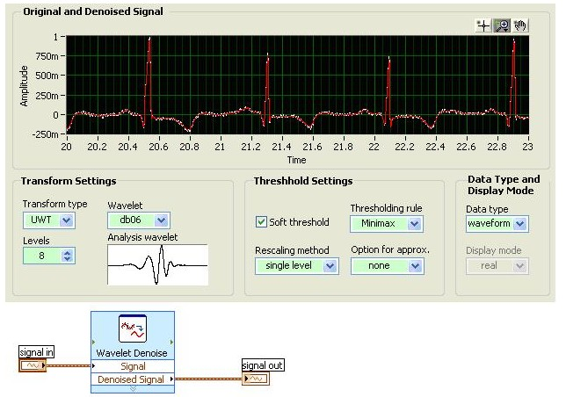

Slide 51
Removing baseline wandering:
Baseline wandering usually comes from the respiration at frequencies between 0.15 Hz and 0.3 Hz, and you can suppress it by a high pass filter.
Wavelet transform also can be used to remove baseline wandering by eliminating the trend of the ECG signal.
Below figure shows the original ECG signal and the resulting ECG signals processed by the digital filter-based and the wavelet transform based approaches.
The resulting ECG signals contain little baseline wandering information but retain the main characteristics of the original ECG signal.
Wavelet transform based approach is better because this approach introduces no latency and less distortions than the digital filter based approach.

Slide 52
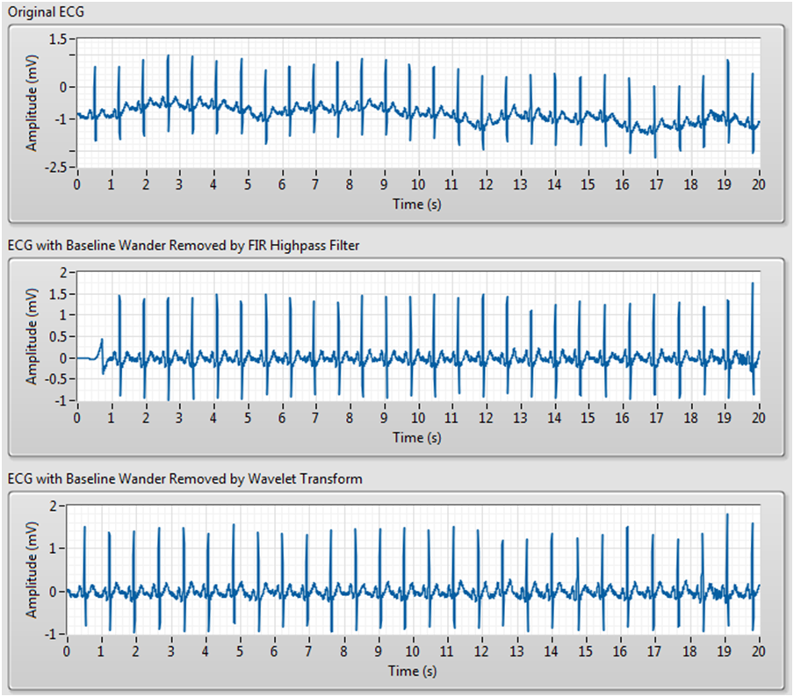

Slide 53
COMPARATORS AND CONVERTERS

Slide 54
COMPARATORS
Comparator, as its name implies, compares two signals voltages, from which one is the signal of interest and the other one is called reference voltage.
It is an open loop op-amp, with two inputs.
As the circuit is open-loop, the output always remains in saturation. But the polarity of saturation is decided by the difference of two inputs.

Slide 55
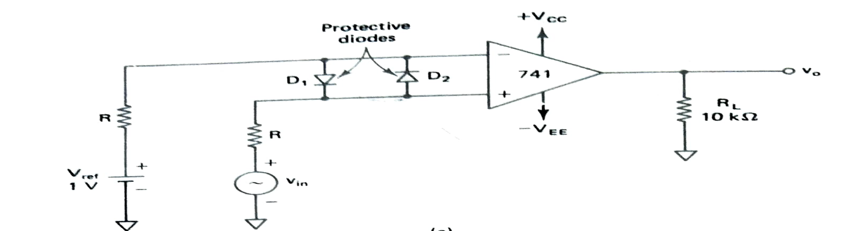
BASIC COMPARATOR

Slide 56
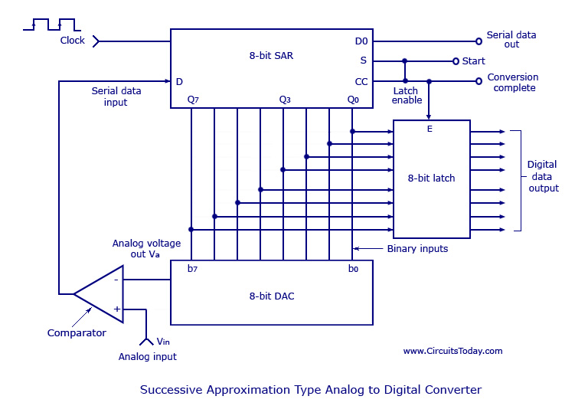
SUCCESSIVE APPROXIMATION ADC

Slide 57
ADC
The main part of the circuit is the 8-bit SAR, whose output is given to an 8-bit D/A converter.
The analog output V_{a} of the D/A converter is then compared to an analog signal V_{in} by the comparator. The output of the comparator is a serial data input to the SAR. Till the digital output (8 bits) of the SAR is equivalent to the analog input V_{in,} the SAR adjusts itself.
The 8-bit latch at the end of conversation holds onto the resultant digital data output.

Slide 58
At the start of a conversion cycle, the SAR is reset by making the start signal (S) high. The MSB of the SAR (Q7) is set as soon as the first transition from LOW to HIGH is introduced. The output is given to the D/A converter which produces an analog equivalent of the MSB and is compared with the analog input V_{in}.
If comparator output is LOW, D/A output will be greater than V_{in} and the MSB will be cleared by the SAR. If comparator output is HIGH, D/A output will be less than V_{in} and the MSB will be set to the next position (Q7 to Q6) by the SAR.
According to the comparator output, the SAR will either keep or reset the Q6 bit. This process goes on until all the bits are tried. After Q0 is tried, the SAR makes the conversion complete (CC) signal HIGH to show that the parallel output lines contain valid data. The CC signal in turn enables the latch, and digital data appear at the output of the latch. As the SAR determines each bit, digital data is also available serially. As shown in the figure above, the CC signal is connected to the start conversion input in order to convert the cycle continuously.

Slide 59
ECG signal
Properties of the electric signals on the skin:
AC signal with bandwidth of 0.05 to to 100 Hz, sometimes up to 1 kHz
About 1 mV peak-to-peak amplitude
External noise at higher frequencies
50/60 Hz interference
Common-mode voltages (common to all electrodes)

Slide 60
ECG SIGNAL
The common-mode voltage is comprised of two parts:
1) 50- or 60-Hz interferences
2) DC electrode offset potential
Other noise or higher frequencies within the biophysical bandwidth come from:
Movement artifacts that change the skin-electrode interface
Muscle contraction or electromyographic spikes
Respiration
Electromagnetic interferences
Noise from other electronic devices that couple into the input

Slide 61
ECG amplifier
The technic usually employed to amplify bioelectric signals is the use of a differential amplifier.
A differential amplifier is an amplifier which amplifies difference between two inputs.
Common mode gain of these amplifiers are nearly zero which makes them less susceptible to noise. (due to high CMRR)
High CMRR of op-amp amplifiers, rejects following two common mode signals:
50 Hz mains interference
DC electrode offset potential
Some noise can be cancelled with a high-input-impedance instrumentation amplifier (INA)
→ removes the AC line noise common to both inputs
→ amplifies the remaining unequal signals present on the inputs

Slide 62
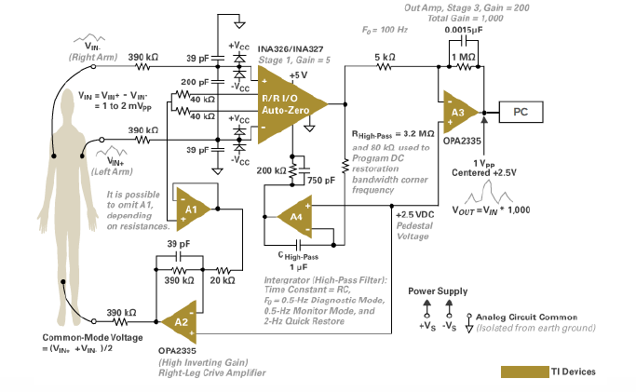

Slide 63
CARDIAC MONITORS
Patient monitoring systems vary greatly in size and configuration depending on manufacturer as well as user, some basic elements are common in all.
Skin electrodes to pick up ECG
Amplifier similar to ECG amplifier discussed before
CRT bedside with small screen, which is specific to the patient . And another which is with large display have the ECG of all the patients in ward, at nurse station.
A rate meter used to indicate average heart rate, might have audible or flashing light for indication of each heart beat
An alarm system actuated by rate meter, to alert nurse or observer

Slide 64
In addition to this, a direct write out device to obtain, a permanent record of ECG seen on CRT
A memory tape loop to record and playback the ECG for 15 to 60 seconds prior to alarm
Additional alarm triggered by ECG parameters other than heart rate, ex. Widening of QRS complex
Electrical circuits to indicate that an electrode has become disconnected or the mechanical failure has occurred somewhere else in monitoring system

Slide 65
PDS
SDN
NFV
Computer Vision
Thank You !!
ELECTROCARDIOGRAM (ECG)
https://github.com/siagianp
https://www.youtube.com/@AmelOline/videos
https://github.com/amelcharolinesgn2/IoT_simulator-mqtt-NodeRed
https://github.com/amelcharolinesgn2/Cloud-Infrastructures
https://github.com/amelcharolinesgn2/ClouD-Infrastructure-SISKA-2025

